Slide 1
Auditing and Taming SQL Server Permissions

Slide 2



Dave Mason
@BeginTry
LinkedIn.com/in/DMasonDBA
DaveMason.me

Slide 3
Agenda
Audit/Inventory
Red Flags
Scaling Back

Slide 4
Server Principals
Logins
Roles
Fixed Server Roles
Role Members

Slide 5
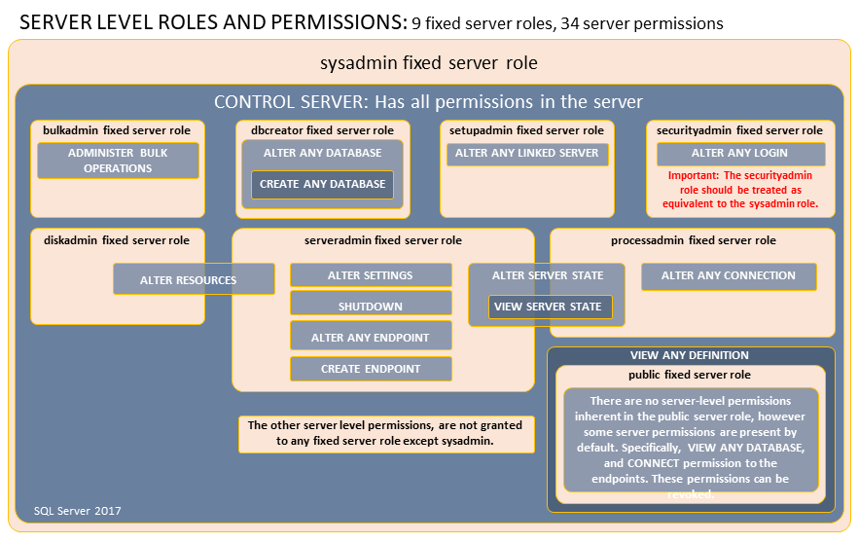
Reference: Learn.Microsoft.com

Slide 6
Database Principals
Users
Roles
Fixed Database Roles
Role Members

Slide 7
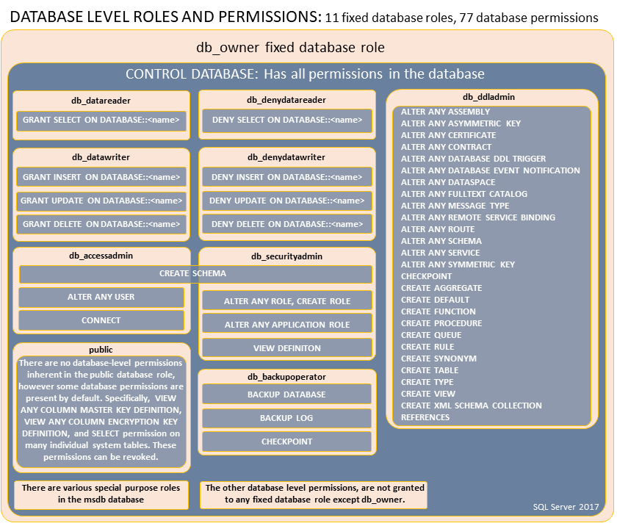
Reference: Learn.Microsoft.com

Slide 8
Demo

Slide 9
Mount Rushmore
sa
[sysadmin]
Database owner
[db_owner]

Slide 10
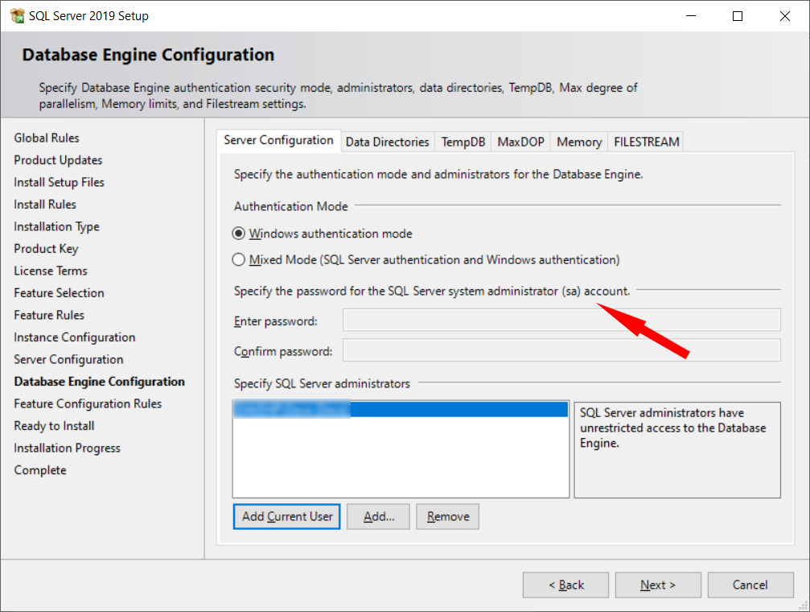
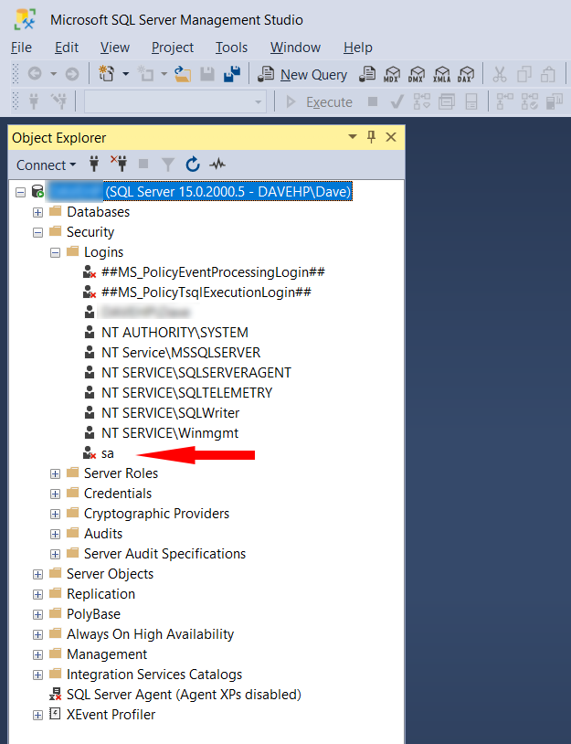
sa

Slide 11
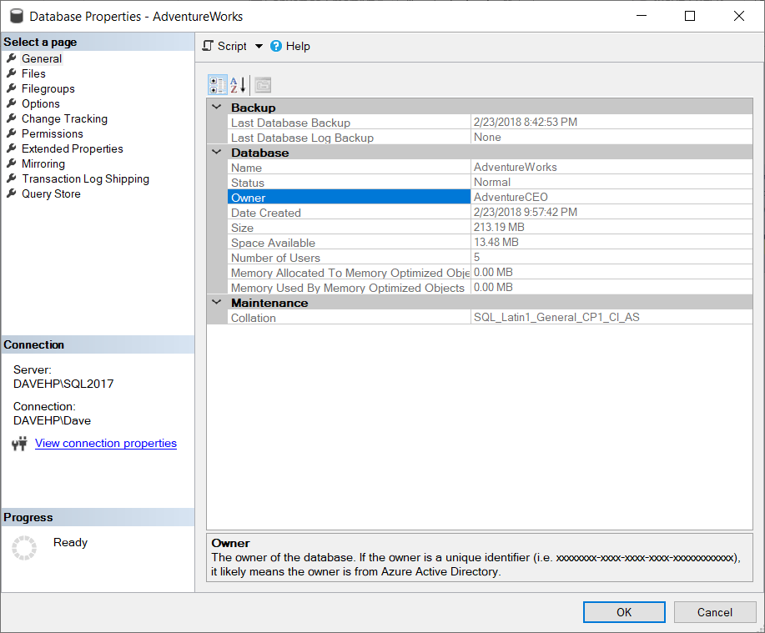
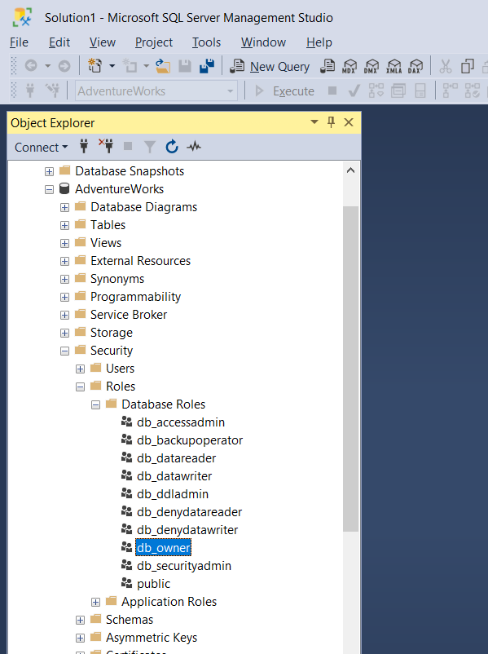
Database Owner vs [db_owner]

Slide 12
Scaling Back
CONTROL SERVER
db_owner
db_datareader, db_datawriter, db_ddladmin
GRANT
DENY, DENY, DENY

Slide 13
Demo

Slide 14
Less Is More
[sa]/[sysadmin] CONTROL SERVER
Database Owner db_owner
db_owner db_datareader, db_datawriter, db_ddladmin
GRANT
DENY, DENY, DENY

Slide 15
Change is hard
Make a plan
Fallback options
Monitoring

Slide 16
Sample Plan for [sa]

Slide 17
Monitor For Missing Authorizations
Extended Event Session
error_reported event

Slide 18
Code Samples
01 Server Permissions ~ Principals and Role Memberships
02 Server Permissions ~ By Principal
03 Server Permissions ~ Fixed Server Roles
04 Database Permissions ~ Principals and Role Memberships
05 Database Permissions ~ By Principal
06 Database Permissions ~ Fixed Database Roles

Slide 19
Questions?

